Slide 1
Chapter 5 Writing a Problem Domain Class Definition

Slide 2
Chapter 5 Topics
Writing class definitions
Defining attributes
Writing methods
Creating an instance
Writing a tester class
Invoking methods
Working with multiple instances
Writing a constructor method

Slide 3
Naming Conventions
Class names begin with a capital letter
Customer, Boat
Attribute names begin with lowercase letters, with subsequent words capitalized
Address, phoneNumber
Method names begin with lowercase letters, with subsequent words capitalized, and usually contain a verb describing what the method does
setAddress, getPhoneNumber

Slide 4
Developing a PD Class Definition
Class Definition Structure
Class definition
The Java code written to represent a class
Class header
Line of code that identifies the class and some of its characteristics
Keywords:
public
Indicates class has public availability
class
Indicates this line of code is a class header

Slide 5
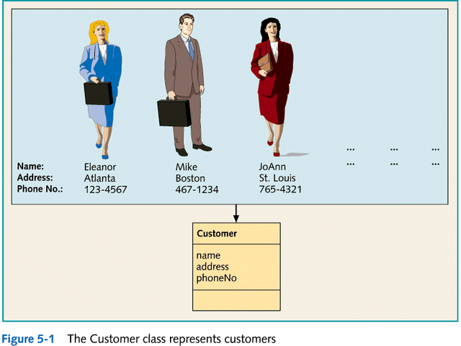

Slide 6
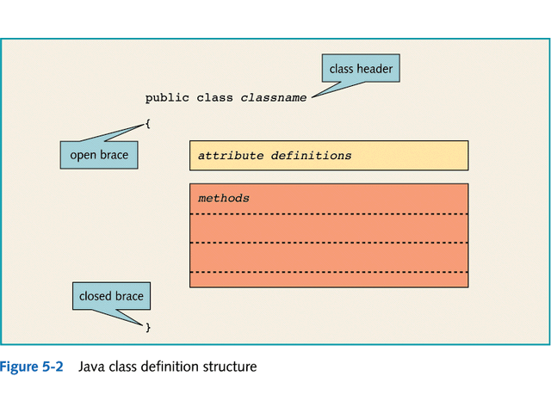

Slide 7
Developing a PD Class Definition
Defining Attributes
Define attributes by declaring variables for each one
Specify accessibility of a variable:
public
Allows any class to access the variable directly
private
Prohibits direct access
Requires accessor method for access by other classes
Accessible only from within class where it is defined
protected
Allows both subclasses and classes defined within the same package to have direct access

Slide 8
Developing a PD Class Definition
Writing Methods
Object interaction via client-server model
Client object
Object sending the message
Invokes server method and possibly sends values in the form of arguments
Server object
Object receiving the message
May return value to client

Slide 9
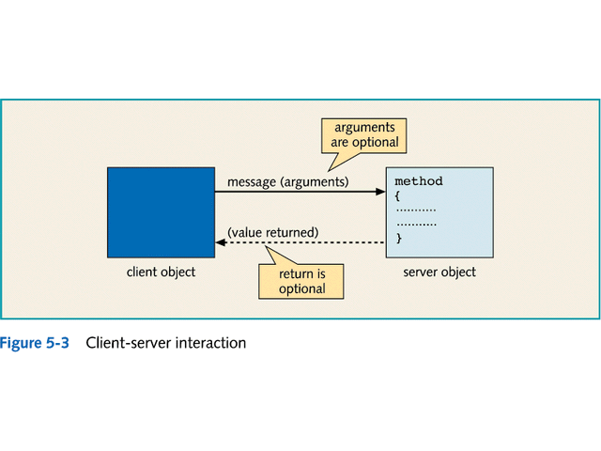

Slide 10
Developing a PD Class Definition
Writing Methods
Method Header (4 parts)
Accessibility
public, private, or protected
Data type
void or data type of returned value
Method name
Following specified conventions
Parameter list
Variable declarations that match the argument parameters

Slide 11
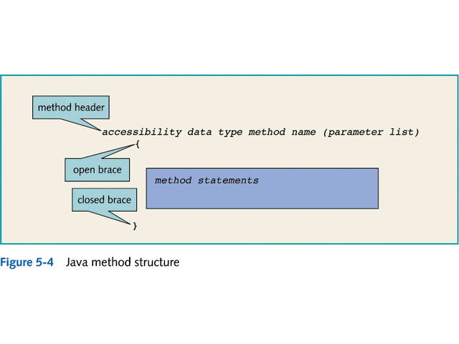

Slide 12
Developing a PD Class Definition
Writing Methods
Accessor methods (standard method)
Get accessor methods (getters)
Named with prefix “get” followed by attribute name
Retrieve attribute values
Set accessor methods (setters)
Named with prefix “set” followed by attribute name
Change attribute values

Slide 13
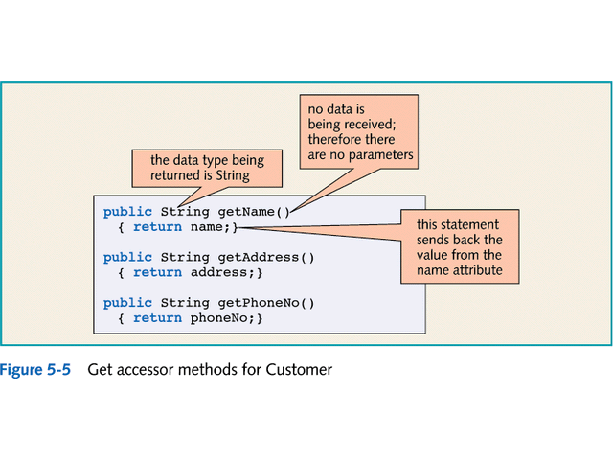

Slide 14
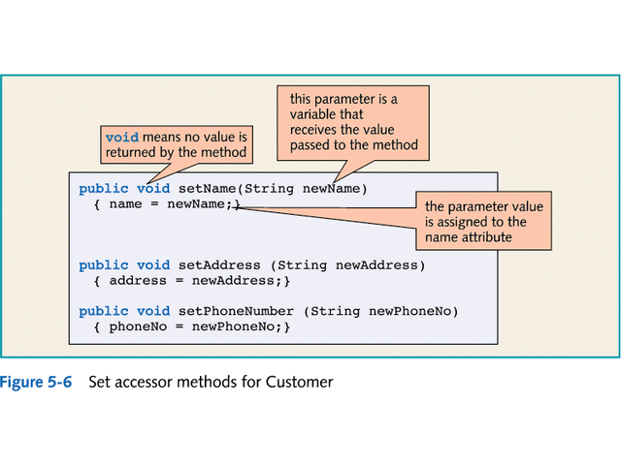

Slide 15
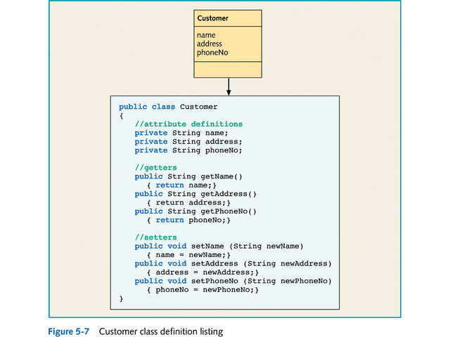

Slide 16
Testing a PD Class
Tester class
Used to simulate the way a client might send messages to a server
To test the proper operation of the server’s methods
Consists of a main method that instantiates a client class object and invokes its methods

Slide 17
Testing a PD Class
Creating an Instance
Define a reference variable
Specify a data type
Use new keyword to create the instance
Customer firstCustomer = new Customer();
Test interactions
Use a sequence diagram to show interactions between client and server

Slide 18
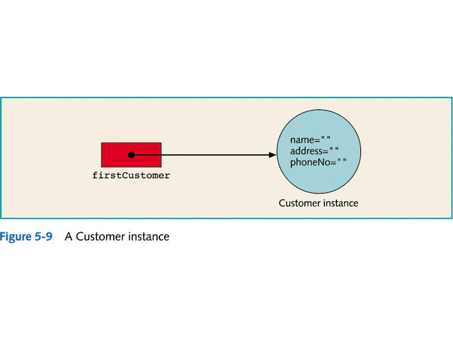

Slide 19
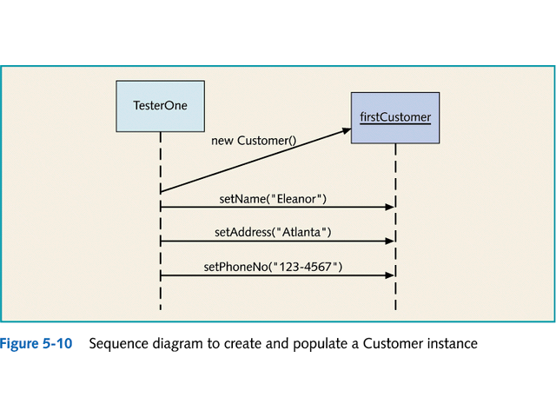

Slide 20
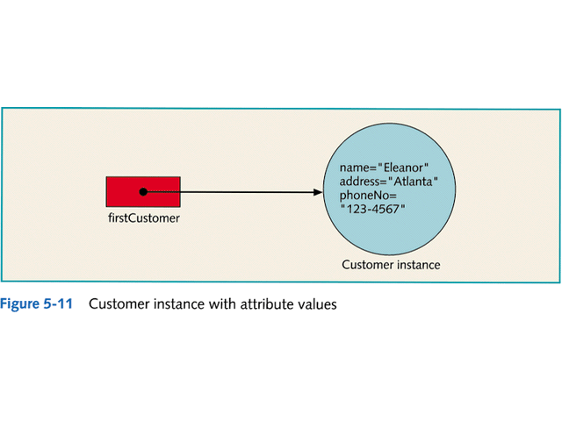

Slide 21
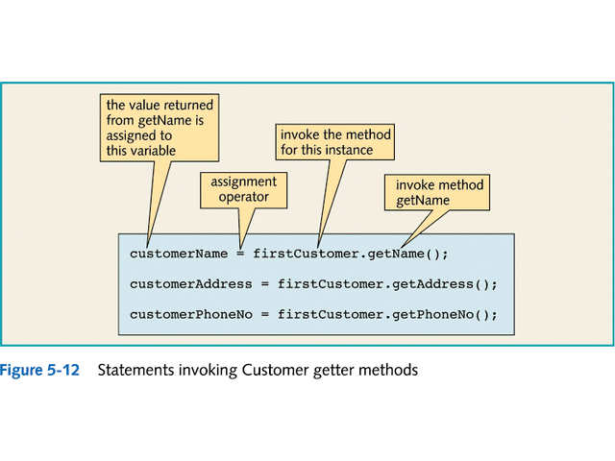

Slide 22
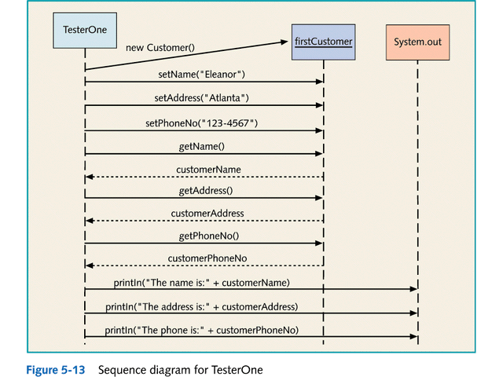

Slide 23
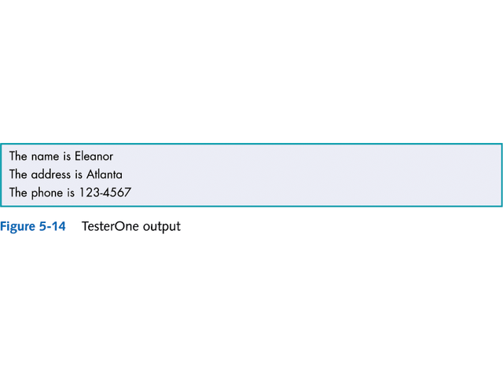

Slide 24
Testing a PD Class
Creating Multiple Instances
The previous process can also be used to test multiple instances from a single tester
Example:
Bradshaw Marina’s customers

Slide 25
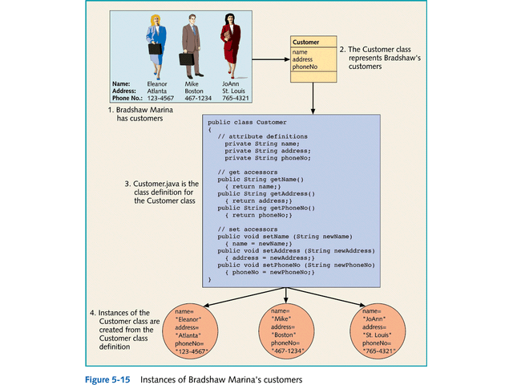

Slide 26
Writing a Constructor Method
Constructor Method
Automatically invoked when a class instance is created using the new operator
Has same name as the class
Has no return type
Java creates a default constructor if no constructor has been explicitly written for a class
public Customer() { }

Slide 27
Writing a Constructor Method
Parameterized Constructor
Has parameter list to receive arguments for populating the instance attributes by:
Calling the accessor (setter) methods for each instance variable
or
Setting the value of the instance variable directly

Slide 28
Writing a tellAboutSelf Method
tellAboutSelf Method
Single method that provides requestor with a String that contains all the instance variable names and values
Alternative to invoking individual accessor (getter) methods

